Slide 1
[Abusive Comments Detection on Social Media Platforms Using NLP with BERT and Transfer Learning]
Project Presentation Submitted
To
Dr. D. Y. Patil Vidyapeeth, Centre For Online Learning, Pune
Submitted By:
Name: [SHUBHAM CHAUDHARY]
ERP ID: [241111543]
PRN No.: [2405020015468]
Under the Guidance of
[Vikas Kumar Atray]
[MBA in AI&ML]
Dr. D. Y. Patil Vidyapeeth, Centre for Online Learning, Pune
2024-2026

Slide 2
Introduction:
The Big Picture: Social media connects the world, but it also creates a breeding ground for cyberbullying and toxic behavior.
The Tech Evolution: Older AI tools just look for "bad words," which means they miss the actual context. We are shifting to Transformer models (like BERT) because they understand how words relate to each other in a sentence.
The Real Challenge: It is incredibly tough for machines to catch sarcasm, passive-aggressiveness, or mixed languages like "Hinglish."
Our Approach: Building a smarter, context-aware system to automatically flag and categorize this toxic behavior before it harms users.

Slide 3
Objective, Scope, and Purpose of Study:
What We Aim to Do: Build a "stacked" AI model combining three different versions of BERT (mBERT, HateBERT, and IndicBERT). The goal is to figure out if a comment is abusive, and if so, what specific kind of abuse it is.
Where We Focused (Scope): We specifically looked at Hindi and code-mixed social media data using the HASOC datasets from 2019 to 2021.
Why It Matters (Purpose): To help digital platforms automate their content moderation, protect human reviewers from psychological trauma, and make online communities safer.

Slide 4
Literature Review
Research Papers used for study : 25
Published articles in Newspapers, Journal and web sites : 11
Books : 2
Company web sites : 1 (FirstSiteGuide cyberbullying statistics)
Study reports : 25

Slide 5
Research Methodology
How We Built It: We designed a "Stacked Ensemble." Instead of relying on just one AI, we let three distinct BERT models work together as a team.
Cleaning the Data: First, we scrubbed out the internet noise—like URLs, hashtags, and @mentions. Then, we used sub-word tokenization to help the AI read misspelled slang.
The Decision Maker: The three BERT models process the text and give their opinions. A 'Random Forest' algorithm then acts as the manager, weighing their inputs to make the final, highly accurate decision.

Slide 6
Data Collection and Analysis
The Source: We merged data from the 2019, 2020, and 2021 HASOC challenges to get a highly diverse mix of real-world internet comments.
The Breakdown: We started with over 13,500 comments. The toxic ones were split into three categories: Hate, Offensive, and Profanity.
Leveling the Playing Field: Because there were naturally more clean comments than toxic ones, we used a technique called random oversampling to balance the dataset perfectly at 9,000 comments per category.
How We Graded the AI: We didn't just look at basic accuracy; we rigorously tested the models using Precision, Recall, and F1-Scores to ensure they weren't just guessing.

Slide 7
Findings
Individual Performance: On their own, our models did well. Standard mBERT hit 90% accuracy, while IndicBERT and HateBERT hovered around 87-88%.
The Power of Teamwork: When we stacked them together using our custom methodology, the results jumped significantly.
Spotting the Trolls (Binary): Our combined model reached a massive 94% accuracy in simply telling apart abusive vs. safe comments.
Categorizing the Toxicity (Multiclass): When asked to specifically identify if the abuse was hate speech, offensive language, or raw profanity, the system still maintained a highly impressive 93% accuracy.

Slide 8
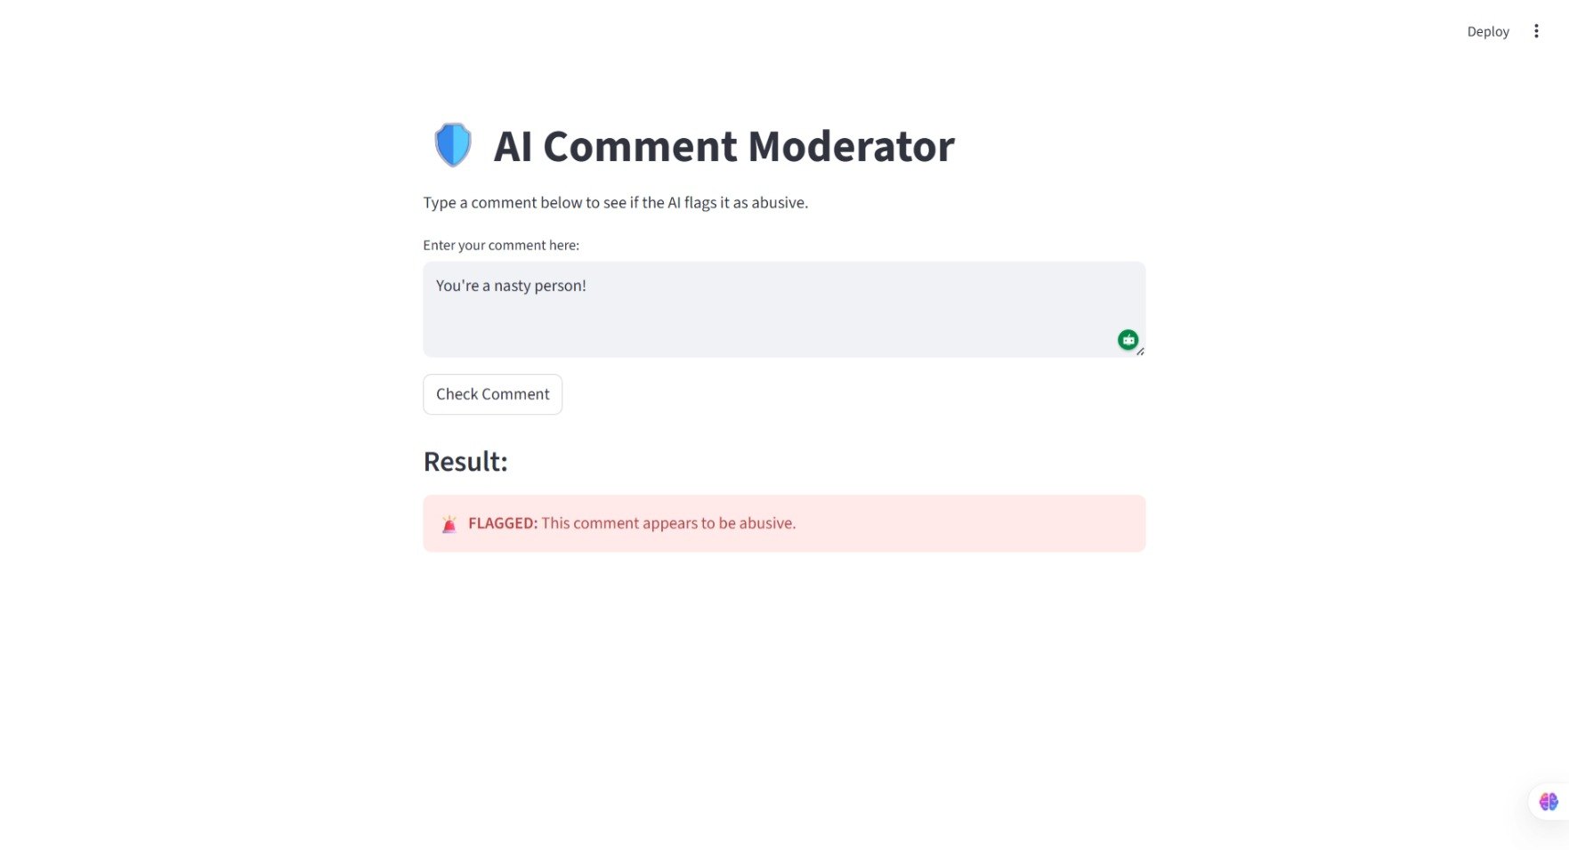
Application Interface

Slide 9
Conclusions
Teamwork Wins: Combining models with different backgrounds (like IndicBERT's local language knowledge and HateBERT's toxicity training) creates a much smarter, well-rounded moderation tool.
Ready for the Real World: This system proves we can automate the heavy lifting of content moderation, saving businesses time and money while keeping platforms safe.
What’s Next? Future versions need to get better at understanding deep sarcasm, adapting to new internet slang as it evolves, and reading emojis alongside text.

Slide 10
References
(Note: Citations shouldn't be heavily altered, but here is a clean, standard format to use)
Kenton, J. D., & Toutanova, L. K. (2019). BERT: Pre-training of deep bidirectional transformers for language understanding. Proceedings of NAACL-HLT.
Rehman, M. Z. U., et al. (2023). User-aware multilingual abusive content detection in social media. Information Processing and Management.
MacAvaney, S., et al. (2019). Hate speech detection: Challenges and solutions. PLoS ONE.
HASOC Dataset Compilations (2019, 2020, 2021).

Slide 11
THANK YOU

